Slide 1
Magnum Opus
A Collaborative Painting Application
Jahn Davis, Casey Jones, Hannah Ludema, Micah Ng

Slide 2
Our Vision
Real-time collaborative painting application
Multiple people paint on the same screen
Unique casual pastime

Slide 3
DEMONSTRATION

Slide 4
User testing results
Pros
Cons
Fun, unique idea
Intuitive design
Painting is easily accessible
Laggy
Paint brush selector hard to push
Lack of zoom feature
Various minor bugs
Notes:
Bug fixes include: Eraser turning off when selecting a new color, panning doesn’t erase your drawing, paint brush color stays the same, etc…

Slide 5
Design
Server/ Collaboration is up and running
Color Wheel implemented
Saving and searching for a canvas
Minor bug fixes
Fixed lag while painting

Slide 6
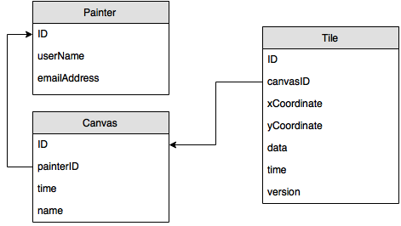
Database structure

Slide 7
Deployment Diagram

Slide 8
Technologies
Android
PostgreSQL
Color Picker by QuadFlask
Java/Jersey server

Slide 9
Assessment
Strengths
Weaknesses
Usable drawing application
UI design is easy to use
Fully functional server/collaboration
Saving and searching
Lack of features
No support for bad canvas names
No thumbnails for saved canvases
Collaboration lag
Notes:
Canvas name can’t have special characters

Slide 10
Future Work
User authentication
Zooming in and out
Uploading pictures
Downloading your drawings onto your device

Slide 11
Questions?
Thank you for listening!

